Slide 1
FRUIT RIPENESS DETECTION
Using Computer Vision and Convolutional Neural Networks
NAME: Shaurya Guliani
Enrollment No: A2305219086
Class: 5Cse-2X

Slide 2
Why Fruit Ripeness Detection is Necessary?
A huge step towards Automatizing the Agriculture Industry
Easy categorization of fruits and vegetables to reduce time spent in manual handpicking of ripe produces
Replaces the human workforce to do the tiresome and time consuming job to increase efficiency

Slide 3
Aim and Objective
Programming a machine learning classification model consisting of a huge database of ripe, unripe and overripe images of bananas and oranges.
Creation of an application which could use the created model to classify (banana or orange in this case) according to its ripeness.

Slide 4
Software and Libraries with versions used
Microsoft Visual Studio Code – 1.57.0
Python - 3.9.1
Tensorflow – 2.5.0
Numpy – 1.19.5
Flask – 2.0.0
HTML/CSS

Slide 5
Implementation
Creation of the CNN model using a big database of images using python along with Tensorflow and Keras.
Construction and Styling the Web Application pages using HTML and CSS.
Using Flask library with python to link the created model with the application and deploy it on local host.

Slide 6
CNN Structure
First layer: Convolutional Layer
Second Layer: Pooling Layer (Max pooling with pool size 2)
Third And Fourth Layer: A repetition of the first two layers to extract accurate features
Fifth Layer: Flattening of the obtained 2D Array to 1D vector
Sixth Layer: A 6 layer full connection to create an Artificial Neural network

Slide 7


Slide 8
Model Accuracy
A 966 image database is used to train the model
250 images are used to test the model
The Model is trained in 20 passes (epochs)
The highest accuracy obtained is 0.9482 in the 19th pass
The lowest accuracy obtained is 0.3944 in the 1st pass

Slide 9
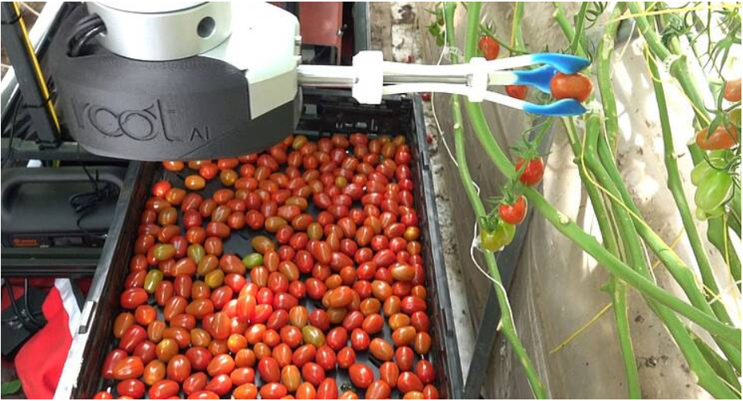
Future Work
Integration with Robotic AIs to perform handpicking tasks.
Automatic Vending machines to provide best quality produce
Root AI’s Tomato Ripeness Detecting arm

Slide 10
Limitations
The application lacks a detection module and might even classify an object which is not in its scope.
The Model focuses on the color scheme features primarily and might face some inaccuracies while classifying data in bulk

Slide 11
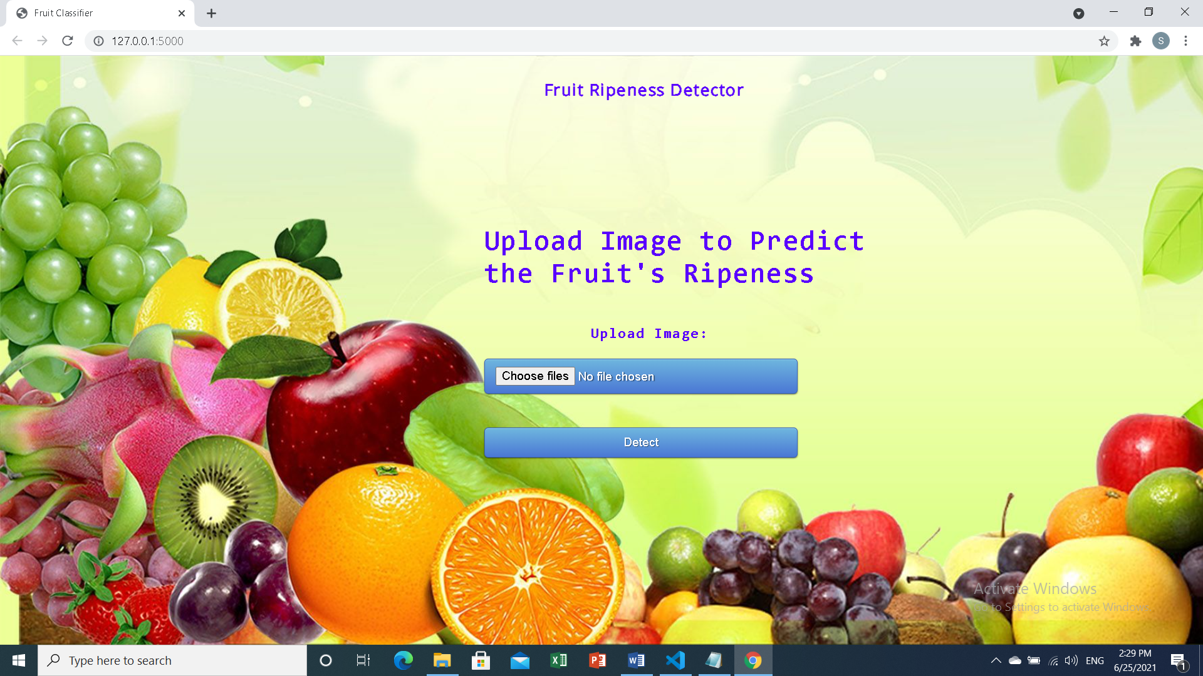

Slide 12
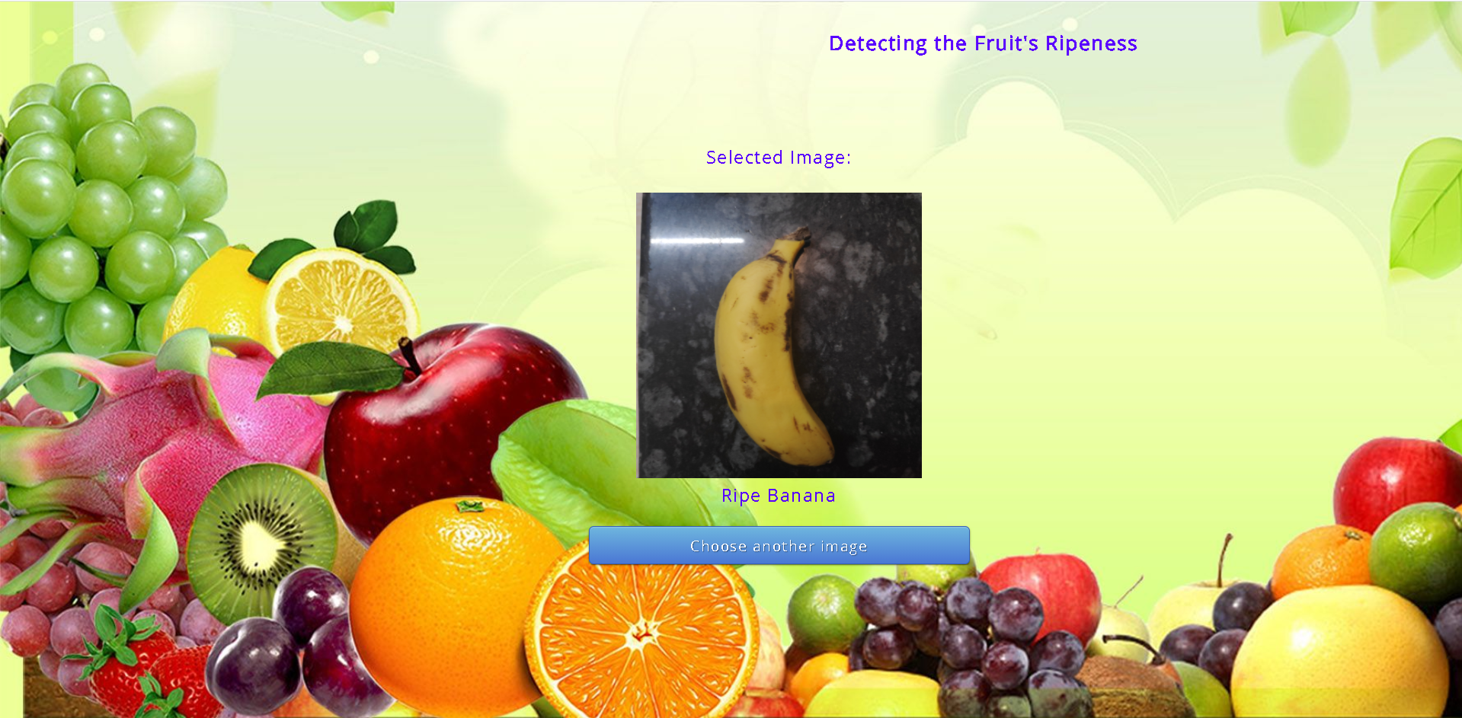
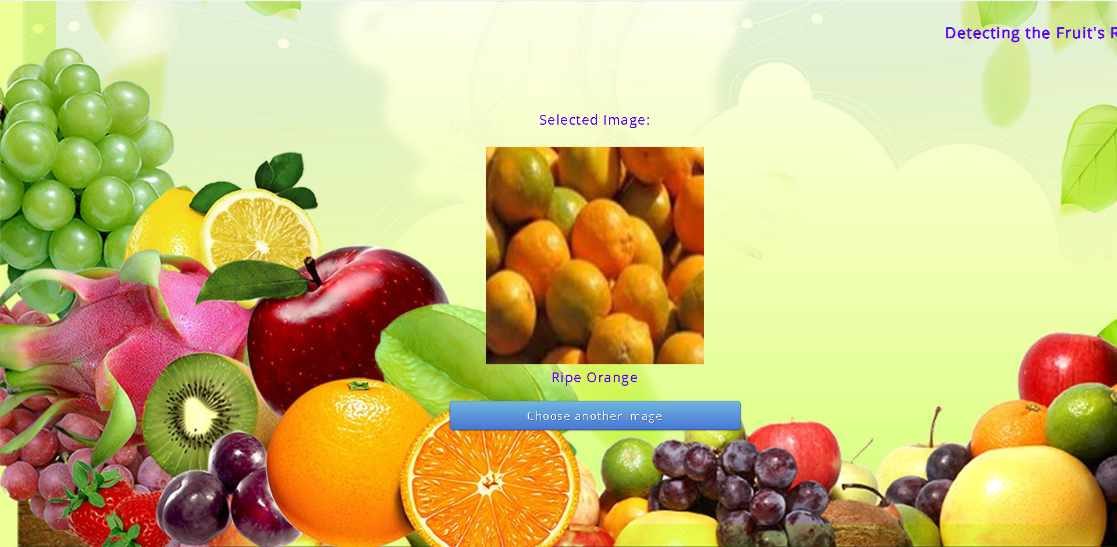
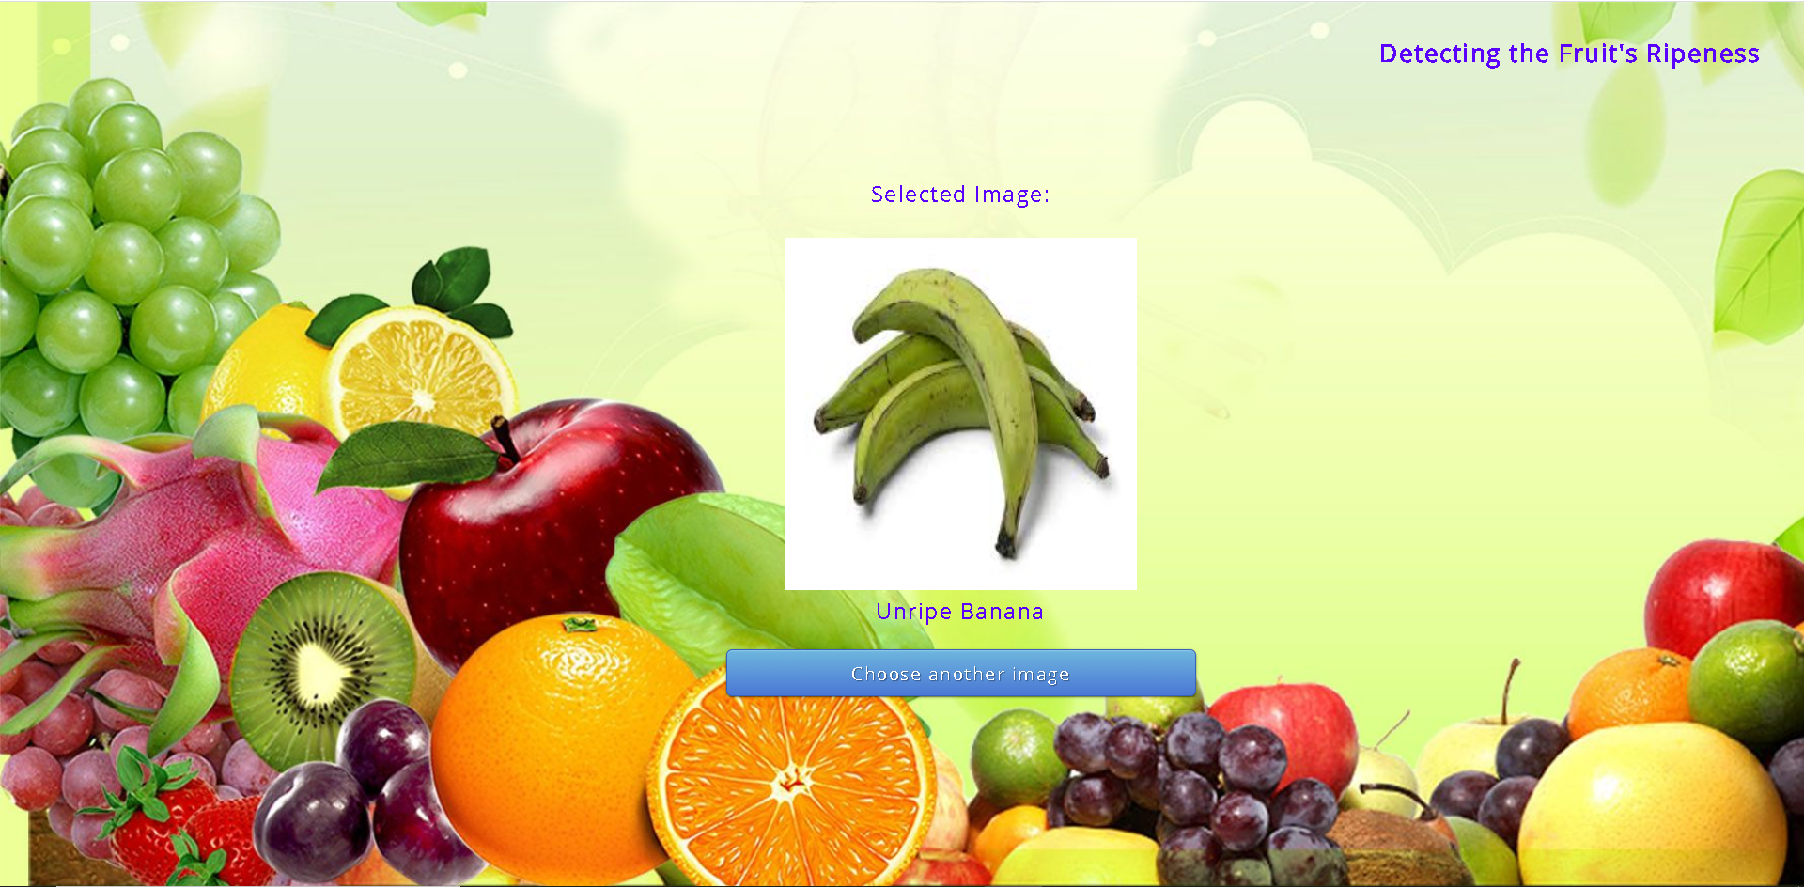
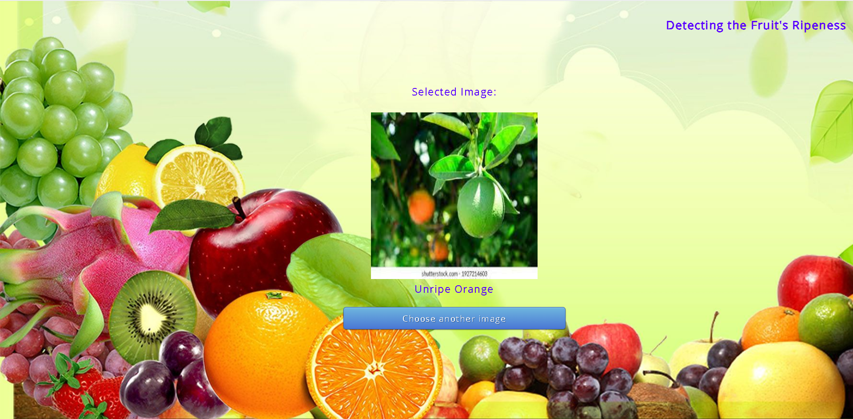
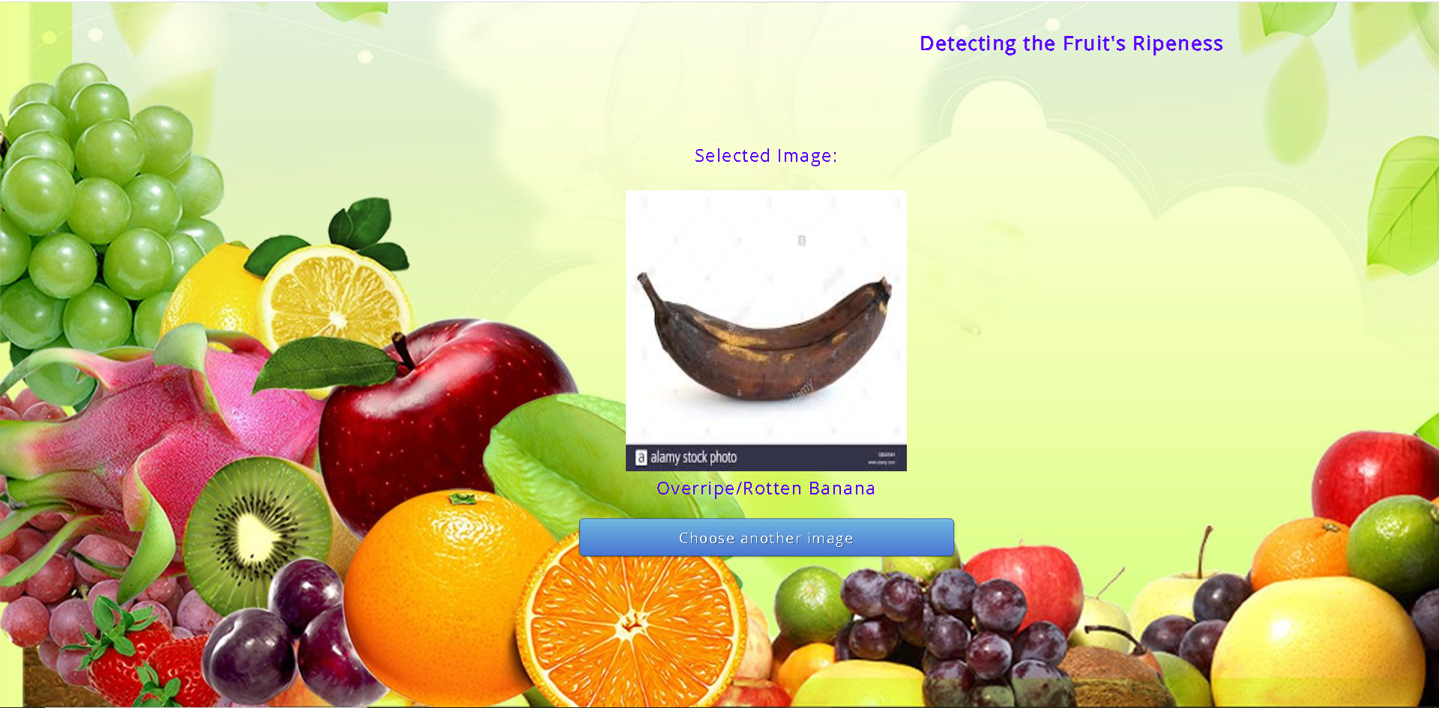
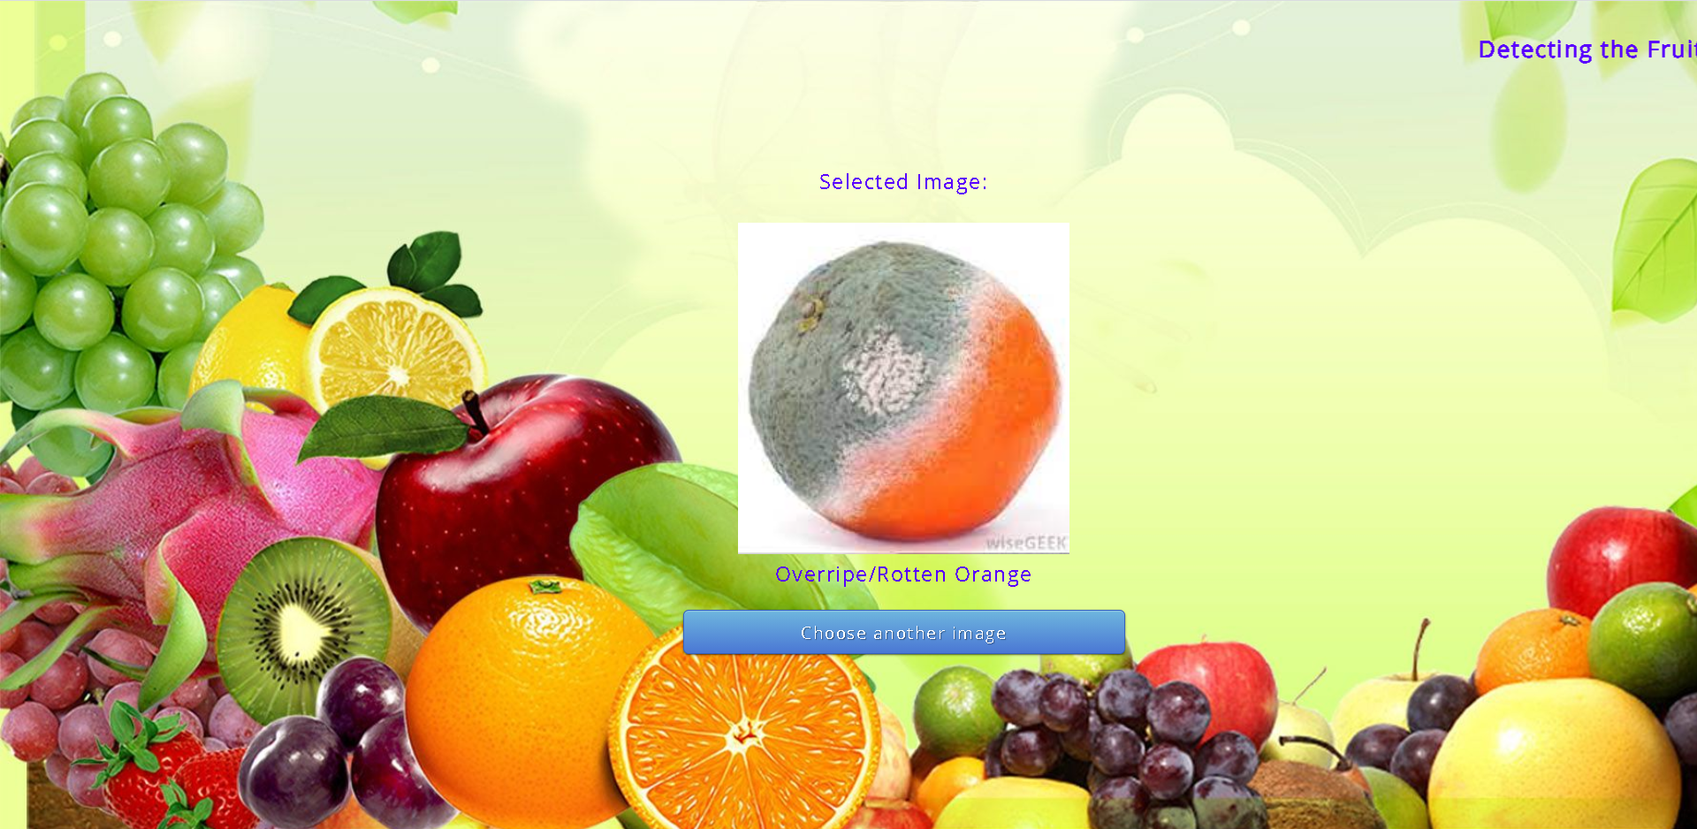

Slide 13
References
"Professor invents 'ripeness' sticker". USA Today. July 27, 2006. Archived from the original on October 13, 2012
McGinley, Susan. "Inventing the RediRipe® Sticker." (2007).
Puttemans, Steven & Vanbrabant, Yasmin & Tits, Laurent & Goedemé, Toon. (2016). Automated visual fruit detection for harvest estimation and robotic harvesting. 10.1109/IPTA.2016.7820996.
Richard Szeliski (30 September 2010). Computer Vision: Algorithms and Applications. Springer Science & Business Media. pp. 10–16. ISBN 978-1-84882-935-0.
Montgomery, John (April 29, 2015). "BUILD 2015 News: Visual Studio Code, Visual Studio 2015 RC, Team Foundation Server 2015 RC, Visual Studio 2013 Update 5"
"Monaco Editor". microsoft.github.io/monaco-editor.
"Language Support in Visual Studio Code". Visual Studio Code. October 10, 2016. Retrieved 2016-10-12
Metz, Cade (November 9, 2015). "Google Just Open Sourced TensorFlow, Its Artificial Intelligence Engine". Wired. Retrieved November 10, 2015.
"Release 2.4.0". 17 June 2020. Retrieved 18 June 2020.
Zhang, Wei (1988). "Shift-invariant pattern recognition neural network and its optical architecture". Proceedings of Annual Conference of the Japan Society of Applied Physics.
"Flask Foreword". Archived from the original on 2017-11-17.

Slide 14
THANK YOU

